Slide 1

Adding Mongolian Language to the spaCy toolkit as Alpha support model
Bayar Demberel
bd12@illinois.edu
CS410 Text information system.
Final Project

Slide 2
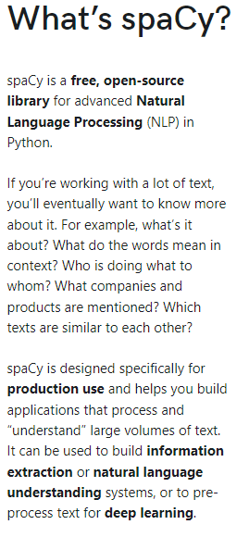
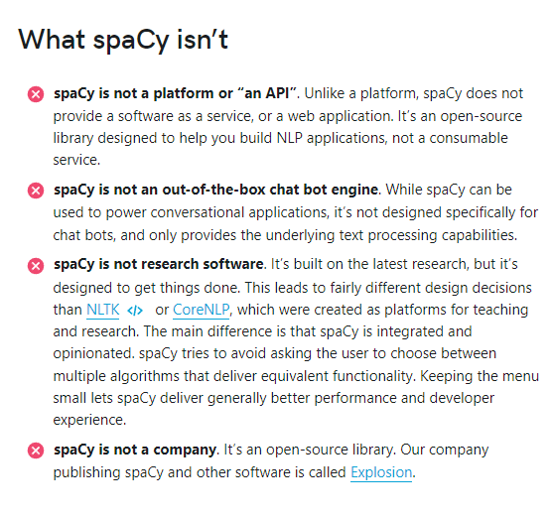
The Spacy toolkit

Slide 3
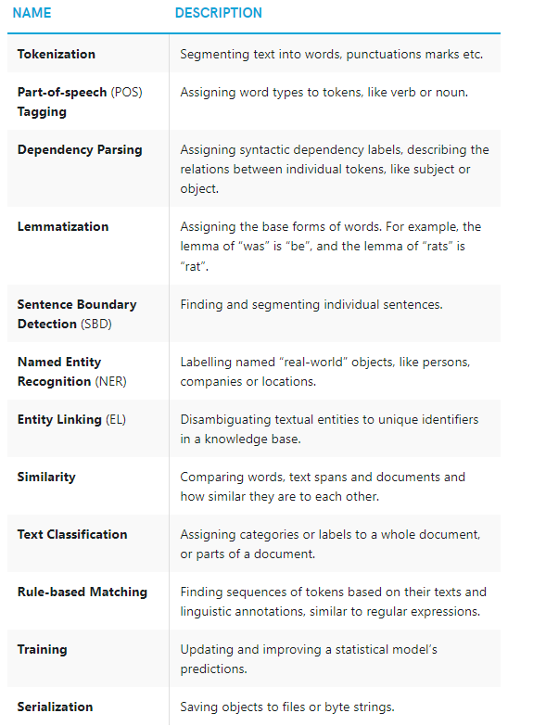
Features

Slide 4
Project goal
Add Mongolian language model compatible with Spacy NLP toolkit as alpha support.
Reason
The spaCy framework does not support the Mongolian language yet, not even alpha support.
What is alpha support?
In spaCy, languages marked as "alpha support" usually only include tokenization rules and various other rules and language data.

Slide 5
Mongolian language
The Mongolian language has two alphabets, Mongolian Cyrillic and Traditional Mongolian scripts. In Mongolia (the country), Mongolian Cyrillic is the official alphabet right now.
This project includes the Mongolian Cyrillic transcript.

Slide 6
What’s included in this package?
Added Mongolian language
Code: mn. name: Mongolian
stop_words.py
List of most common words of the Mongolian language that are often useful to filter out.
Some special-case rules for the tokenizer, for example, abbreviations
punctuation.py
Regular expressions for splitting tokens. It includes rules for infixes.
tokenizer_exceptions.py
lex_attrs.py
Custom functions for lexical attributes on tokens, e.g., like_num, numeric words in the Mongolian language
examples.py
Some sample words, sentences in the Mongolian language for testing inside the spaCy.
__init.py
Create classes for linking the above language pieces.
test_tokenizer.py
Test cases for tokenization for text in the Mongolian language.

Slide 7
Has it been included in the spaCy officially yet?
No, not yet. Contributing to the spaCy community needs a lot of effort, and it is going in progress.
How to use it?
Because this package has not been officially included in spaCy yet, you need to clone the whole package and build it locally to use in your applications
Where can I find the whole package?
You can clone or download the project from below link and build it locally, and then you can use it in your applications.
https://github.com/bayarra/spaCy

Slide 8
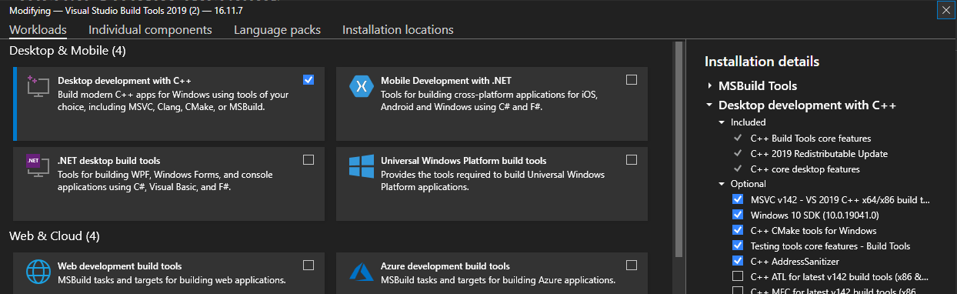
Required tools for Building the spaCy
C++ Build Tools
For Windows:
Download and install Visual Studio Build Tools
https://visualstudio.microsoft.com/downloads/#build-tools-for-visual-studio
Check the Desktop development with C++

Slide 9
Required packages for Building the spaCy
python
cython. (pip install Cython)
and some python packages needed to be installed
Preferred to be installed on virtual environment
Download the project source
https://github.com/bayarra/spacy.lang.mn

Slide 10
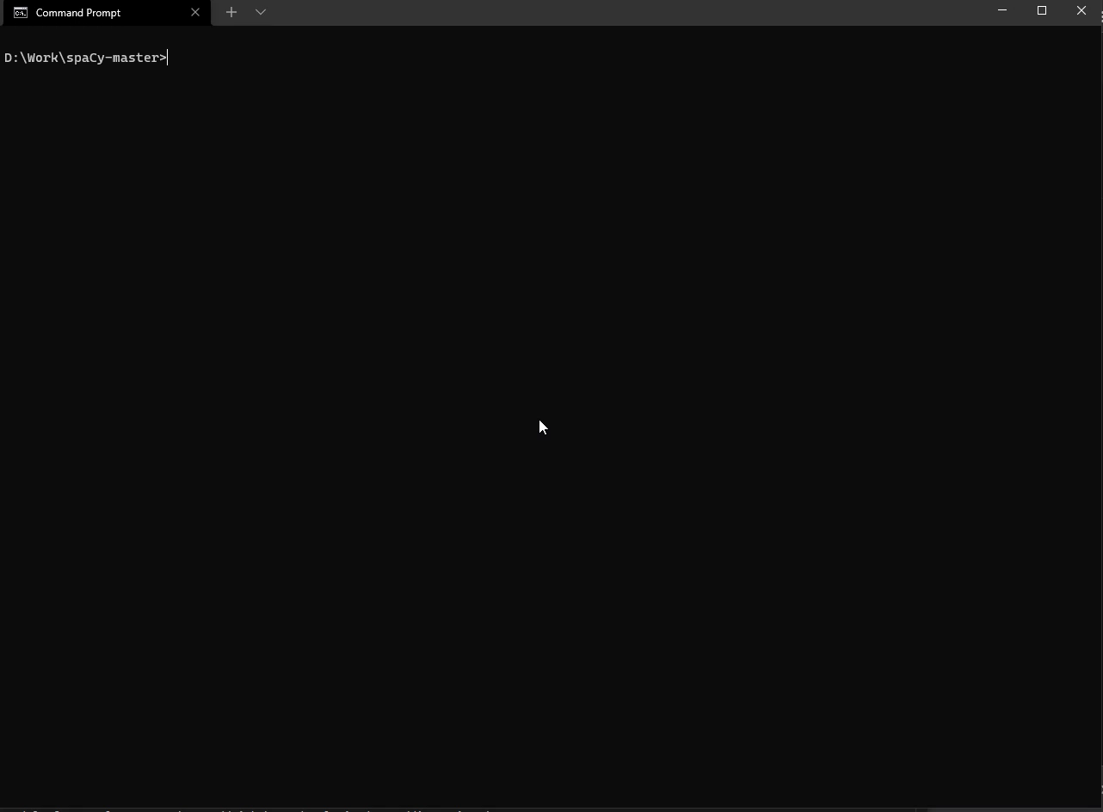
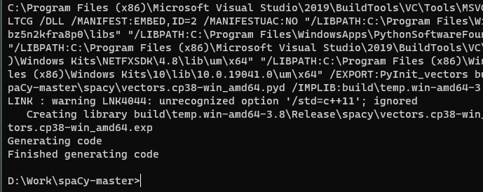
Building the spaCy
From the command prompt:
Go to the downloaded source folder
Run command: python setup.py build_ext –inplace
It will take couple minutes to finish compiling
Here’s the finished result:
Please play the video if you want to view

Slide 11
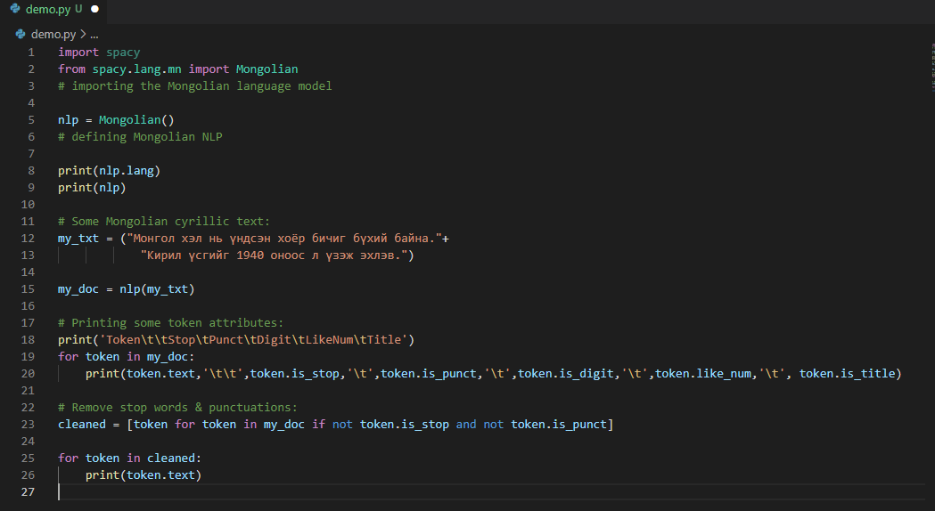
Usage
Let’s run below demo python file

Slide 12
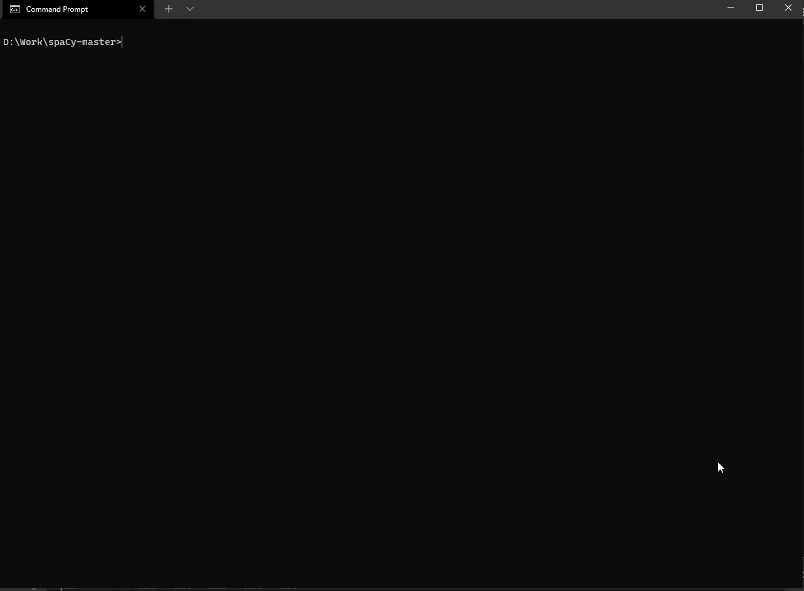
Running
Please play the video if you want to view

Slide 13
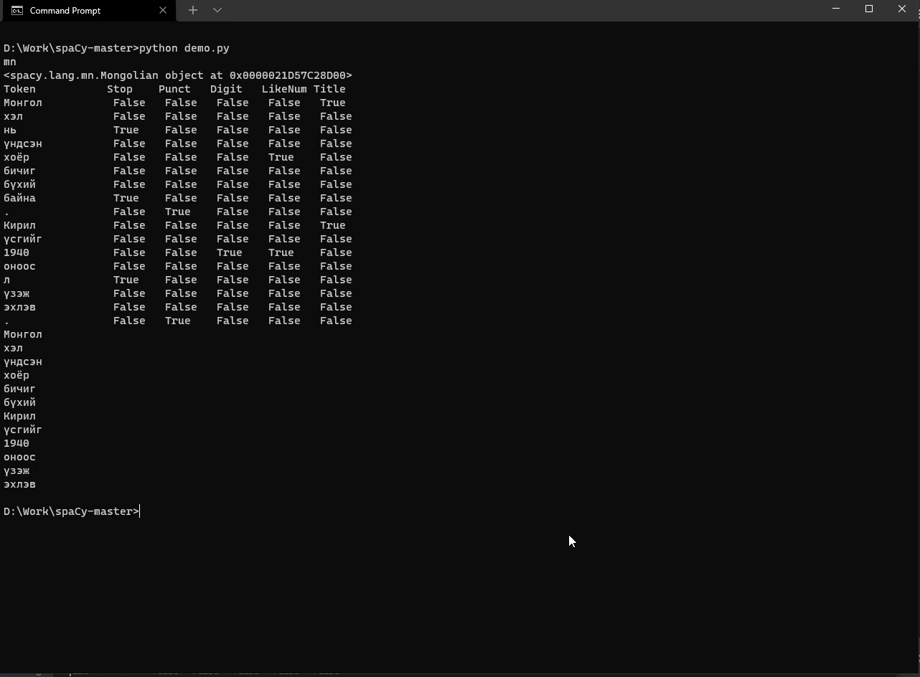
Demo 2
Please play the video if you want to view

